Slide 1
NEUROFEEDBACK AND CHRONIC PAIN
Massachusetts School of Professional Psychology
10/24/11

Slide 2
Edward Jacobs, Ph.D., BCN Board Certied in Neurofeedback
Edward Jacobs, Ph.D. & Associates
12 Parmenter Road
Londonderry, NH 03053
(603) 437-2069 ext. 10
ehjpsych@aol.com
www.jacobsassociates.org

Slide 3
Acknowledgments
Significant content was adapted from:
Jensen, MP, Sherlin, LH, Hakimian, S & Fregni, F (2009). Neuromodulatory approaches for chronic pain management. Journal of Neurotherapy, 13,4 pp 196-213
and
Neurofeedback in a Clinical Practice course syllabus, EEG Spectrum International, Spokane, WA

Slide 4
Overview
Cortical organization
The EEG, brain wave frequencies
Chronic Pain: Cortical basis
Neurofeedback is biofeedback for the brain
Neurofeedback history
Neurofeedback and chronic pain: research
Neurofeedback and chronic pain: case examples

Slide 5
Overview
National Institute of Neurological Disorders and Stroke of the National Institutes of Health
“What is Chronic Pain?
While acute pain is a normal sensation triggered in the nervous system to alert you to possible injury and the need to take care of yourself, chronic pain is different. Chronic pain persists. Pain signals keep firing in the nervous system for weeks, months, even years. There may have been an initial mishap – sprained back, serious infection, or there may be an ongoing cause of pain – arthritis, cancer, ear infection, but some people suffer chronic pain in the absence of any past injury or evidence of body damage. . . “
www.ninds.nih.gov/disorders/chronic_pain.htm

Slide 6
Cortex Organization

Slide 7
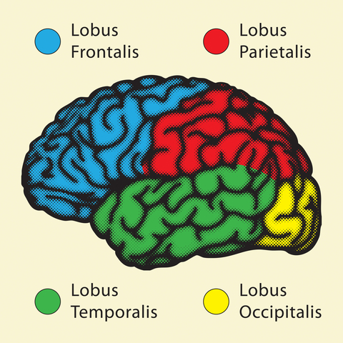
Cortex Organization

Slide 8
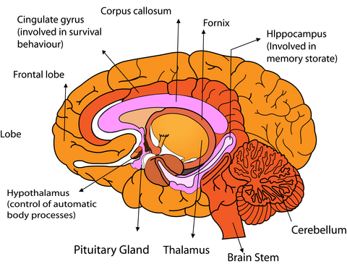
Cortex Organization
Subcortical Structures

Slide 9
Pyramidal neuron

Slide 10
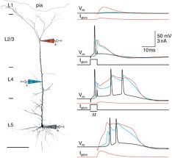
Pyramidal neuron: approx. 100,000 neurons beneath each electrode

Slide 11
Cortex Organization
International 10-20 system of electrode placement

Slide 12
The EEG

Slide 13
The EEG
Hans Berger
German neuropsychiatrist
1924 demonstrated the existence of electric voltage fluctuations in the human brain. Published in 1929.
recorded the first human electroencephalogram (EEG), which amplified tiny changes in electrical flow between a pair of electrodes placed on a patient's skull.
Demonstrated EEG variations between normal and brain-injured patients, and between patients with their eyes open and eyes closed.

Slide 14
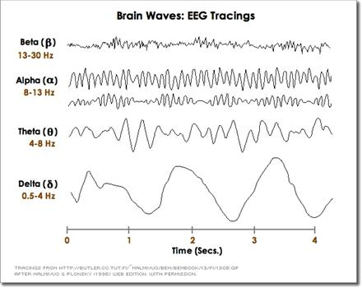
The EEG
EEG recordings represent electrical firings as waves, that reflect the frequency and amplitude of the signal.

Slide 15
The EEG
Frequency
Measured in Hz

Slide 16
The EEG
Amplitude
Measured in microvolts

Slide 17
The EEG
Phase

Slide 18
The EEG
Delta .5 – 4 Hz
Slowest frequency band
Most prominent during sleep
Often associated with TBI
Excessive delta while awake can interfere with processing

Slide 19
The EEG
Theta 4 - 7 Hz
Internal locus
Excessive theta: inattentive, distracted
Increases when visualizing, imagining

Slide 20
The EEG
Alpha 8-12 Hz
Transitional state between internal and external locus
Relaxed, disengaged
Slow alpha: inattentiveness, depression, lack of motivation, inefficient processing
Fast alpha: calm, focused
Different effects in different regions of the brain

Slide 21
The EEG
SMR (low beta) 12 – 15 Hz
Calm, external attention
Motor stillness
Internal inhibition

Slide 22
The EEG
Beta 15 – 18 Hz
Enhanced cognitive processing
External focus with active engagement

Slide 23
The EEG
High beta 22 – 36 Hz
High arousal state
Tension, anxiety, fear, excitement

Slide 24
The EEG
EEG demonstration

Slide 25
Chronic Pain: Cortical Basis

Slide 26
Chronic Pain
Neurophysiology of Pain: History
Early 20th Century: Pain as simple reflexive response to physical damage
Nociception transmitted from peripheral area of damage directly to brain
Pain a function of the amount of damage or inflammation of the injured tissue
Brain viewed as primarily a passive recipient of sensory information

Slide 27
Chronic Pain
Gate control theory (Melzack & Wall, 1965)
Pain input modulated by spinal cord before reaching the brain
Neuroimaging studies
Role of the brain
Pain influenced by multiple, interactive neural processes that modulate pain information at many levels, including the cortex
Multiple cortical sites involved
Somatosensory cortex sites, insular cortex, anterior cingulate, prefrontal cortex, thalamic nuclei

Slide 28
Chronic Pain
Apkarian, Bushnell, Treede & Zubeita, 2005
Craig, 2003a, b
DeLeo, 2006
Katz & Rothenberg, 2005
Melzack, Coderre, Katz & Vaccarino, 2001
Miltner & Weiss, 1998
Rainville et al, 1997
Tinazzi et al, 2000

Slide 29
Chronic Pain
Neural adaptation
Neural networks response to repeated stimulation can be altered: CNS changes, neural plasticity
Flor, 2003
Katz & Melzack, 1990
Increased sensitivity to noxious stimulation with repeated exposure
Exposure to pain increases sensitivity to pain
Contributes to chronicity
Bromm & Lorenz, 1998

Slide 30
Chronic Pain
Changes in CNS affects endocrine and immune systems
Top-down regulation
Fregna, Pascual-Leone & Freedman, 2007

Slide 31
Chronic Pain
Plastic changes in neural network including areas concerning somatosensory and emotional processing
Rome, HP & Rome, JD (2001)
Neuroplastic processes in corticolimbic structures link the sensory and affective experiences of pain: “limbically augmented pain syndrome”
Kindling
Exposure to a noxious stimulus (emotional or physical trauma) results in a sensitized corticolimbic state
Amplification, spontaneity, neuroanatomic spreading and cross-sensitization
Treatment refractory pain
Disturbances of mood, sleep, energy, libido, memory/concentration, behavior, stress tolerance

Slide 32
Chronic Pain
Overlap between depression symptoms and pain and the amelioration of pain symptoms with anti-depressants
Lindsay & Wyckoff, 1981

Slide 33
Chronic Pain
“. . . pain not only stimulates sensory areas of the brain but also powerfully activates brain areas involved in emotion, such as the anterior cingulate cortex (ACC), a region governing emotional aspects of pain, and the amygdala, which mediates fear and other feelings.”
Porreca, F. and T. Price. When pain lingers. Scientific American. September 2009. Pp.34-41

Slide 34
Chronic Pain
Fields, H. The psychology of pain. Scientific American Mind. September/October 2009. Pp. 42-49
“body’s pain-control circuit . . stretches from the brain’s cerebral cortex in the frontal lobes through underlying brain structures, including the periaqueductal gray, to the spinal cord, where pain-sensitive nerve fibers connect to neurons that transmit pain signals from the rest of the body . . .cognitive influences on pain operate through this modulatory pathway”

Slide 35
Chronic Pain
10 OCTOBER 2003 VOL 302 SCIENCE www.sciencemag.org
Does Rejection Hurt? An fMRI Study of Social Exclusion
Eisenberger, Lieberman, Kipling, Williams
“A neuroimaging study examined the neural correlates of social exclusion and
tested the hypothesis that the brain bases of social pain are similar to those
of physical pain. Participants were scanned while playing a virtual balltossing
game in which they were ultimately excluded. Paralleling results
from physical pain studies, the anterior cingulate cortex (ACC) was more
active during exclusion than during inclusion and correlated positively with
self-reported distress. Right ventral prefrontal cortex (RVPFC) was active
during exclusion and correlated negatively with self-reported distress.
ACC changes mediated the RVPFC-distress correlation, suggesting that
RVPFC regulates the distress of social exclusion by disrupting ACC
activity.”

Slide 36
Chronic Pain
Evidence of cortical involvement in the experience and amelioration of pain comes from successful clinical interventions that alter cortical activity
fMRI studies (deCharms, et al, 2005): anterior cingulate
Direct cortical electrical stimulation of the motor cortex (Nguyen et al, 1999; Nuti et al, 2005)
Repeated Transcranial Magnetic Stimulation (rTMS) (Lefaucher et al, 2001; Pleger et al, 2004)
Transcranial Direct Current Stimulation (tDCS) (Antal et al, 2001; Nitsche & Paulus, 2001)

Slide 37
Chronic Pain
Hypnosis (Montgomery et al, 2000; Patterson & Jensen, 2003; Jensen, Barber et al, 2008)
Associated with reductions in cortical activity: PET and fMRI (Hofbauer et al, 2001; Rainville et al, 1997)
Hypnotizable individuals show more theta and alpha activity before and during hypnosis (Crawford, 1990; Williams & Gruzelier, 2001)

Slide 38
Chronic Pain
Studies identifying the dorsal anterior cingulate cortex (dACC)
fMRI feedback (DeCharmes et al, 2005)
Standardized Low Resolution Electromagnetic Tomography (sLORETA) (Ozier et al, 2008)
Implications for training at FZ or nearby (F1, F2)

Slide 39
Chronic Pain
Problems with these methods
Invasive (direct cortical stimulation)
Requires expensive equipment (rTMS, fMRI)
Can be uncomfortable (rTMS, fMRI)
Difficulty with “blinding” (rTMS)
Many individuals are not hypnotizable (hypnosis)

Slide 40
Chronic Pain
Relationship between electroencephalographic activity and the experience of pain
With more intense pain stimulation, all EEG frequencies increase in power, but beta activity increases more
Alpha activity decreases
Acute pain relief associated with decreases in beta and increases in alpha activity
Bromm et al (1986), Bromm, Meier & Scharein (1986), Chang et al (2001), Chen et al (1983), Huber et al (2006), Bromm & Lorenz (1998), Chen (1993, 2001), Kakigi et al (2005), Pelletier & Peper (1997)

Slide 41
Chronic Pain
Subjective experience of pain associated with lower amplitudes of alpha and higher amplitudes of beta activity

Slide 42
Chronic Pain
Chronic pain associated with neurological disorders (e.g. spinal cord injury) show higher amplitude of theta activity in addition to higher amplitudes of beta and lower amplitudes of alpha
Pain meds: the same pattern, but less severe
Candidates for CLT (central lateral thalamotomy)
Following surgery
Reduction in pain
Normalization of EEG patterns

Slide 43
Chronic Pain
Sarnthein et al (2006), Stern, Aufenberg et al (2006), Stern, Jeanmonod & Sarnthein (2006), Boord et al (2008)

Slide 44
Chronic Pain
Evidence shows that the experience of pain is linked to EEG activity
Teaching patients to alter EEG activity to reflect activity that has been shown to be associated with reduced pain may be promising

Slide 45
Neurofeedback History

Slide 46
Neurofeedback History
Classical conditioning of the human EEG: 1940’s
Jasper & Shagass, 1941a
Jasper & Shagass, 1941b
Knott & Henry, 1941
Voluntary control over alpha blocking with subvocal verbal commands paired with visual cues (lights on/lights off)
Classical conditioning, 1960’s
Wyrwicka, Sterman & Clemente, 1962
Pairing neutral stimulus with electrical stimulation of basal forebrain resulted in this auditory stimulus inducing sleep preparatory behavior

Slide 47
Neurofeedback History
M. Barry Sterman, Ph.D.
Professor UCLA, Departments of Neurobiology and Psychiatry
Sleep research with cats
Operantly conditioned cats to increase 12-15 Hz activity over the sensorimotor cortex (1967, 1968)

Slide 48
Neurofeedback History
Suppression of motor excitability with reductions in muscle tone, reflex amplitudes and cellular discharge in motor pathways that were associated with the learned EEG response

Slide 49
Neurofeedback History
M. Barry Sterman, Ph.D.
Showed that operant conditioning of brainwaves could occur
Showed specific effect of increasing one particular frequency

Slide 50
Neurofeedback History
M. Barry Sterman, Ph.D.
NASA research
Exposure to component of rocket fuel
Monomethyl Hydrazine
SMR trained cats more seizure resistant
Average latency of convulsions was 3x greater in previously trained cats than in untrained cats
25% of trained cats were completely seizure free
75% of trained cats had 2x the latency of convulsions as controls

Slide 51
Neurofeedback History
M. Barry Sterman, PhD.
1972, 1974 conditioned EEG activity in humans
Meta analysis of published studies in epilepsy
82% significant (>30%) reduction in seizures
50% average reduction in seizures and seizure severity
5% had complete control for up to one year

Slide 52
Neurofeedback History
Joe Kamiya’s research on alpha (1968)
Conscious control over alpha activity
Perceive when they increased alpha

Slide 53
Neurofeedback History
Joel Lubar’s (Univ. Tennessee) research on ADHD
Increased theta, decreased beta at mid frontal cortex
Increasing beta, decreasing theta results in amelioration of ADHD symptoms

Slide 54
Neurofeedback History
ADHD
10 published randomized control studies
All showed significant reduction in symptoms
4 studies: neurophysiological changes associated with symptom reduction
Only 3 studies: blinding and sham tx
Small n
Numerous clinical case studies reported

Slide 55
Neurofeedback History
Numerous clinical case studies in: depression, anxiety, LD, OCD, TBI, chronic pain, reactive attachment disorder, trauma survivors

Slide 56
Neurofeedback & Chronic Pain

Slide 57
Neurofeedback & Chronic Pain
Neurofeedback studies
Gannon and Sternbach, 1971
Patient with three year history of severe headaches following multiple head traumas
32 hours of training alpha in occipital region
Increase alpha from 20% to 90% of the time with eyes closed
Increase alpha to 50% of the time with eyes open
Headaches decreased
Able to read for twice as long (30 min) without a headache

Slide 58
Neurofeedback & Chronic Pain
Andreychuk and Skriver, 1975
33 migraineurs
Three treatments:
Handwarming biofeedback
Autogenic relaxation instructions
Left and right occipital alpha enhancement feedback
10 30-minute sessions
Headache reductions in all conditions

Slide 59
Neurofeedback & Chronic Pain
Melzack and Perry, 1975
24 patients, multiple chronic pain conditions
Including chronic back pain, peripheral nerve injury, pain from cancer
Three conditions
Self-hypnosis and alpha enhancement neurofeedback
Self-hypnosis alone
Alpha enhancement alone
Larger increases in alpha output and decreases in pain over the course of treatment for the hypnosis and neurofeedback group

Slide 60
Neurofeedback & Chronic Pain
Cohen, McArthur and Rickles, 1980
42 migraineurs
One of four biofeedback conditions
Forehead cooling/handwarming
Frontalis EEG reduction
Temporal artery vasocontriction
Alpha enhancement over right occipital and parietal lobes
All reported significant reduction in headaches
No significant changes in alpha activity in neurofeedback group

Slide 61
Neurofeedback & Chronic Pain
Caro and Winter, 2001
15 fibromyalgia patients
40 or more sessions reinforcing 12-15 Hz (SMR or low beta) and inhibiting 4-7 Hz (theta)
Significant improvement on a test of attention
Strong correlation between improvements in attention and decreases in tender point scores
Weak to moderate correlations between attention scores and patient ratings of fatigue

Slide 62
Neurofeedback & Chronic Pain
Sime, 2004
Case report, trigeminal neuralgia
29 neurofeedback and 10 biofeedback sessions
Electrode placement and bandwidths varied
Temporal lobe and sensory-motor strip electrode placements
Consistent inhibits: 2-7 Hz (delta-theta) and 22-30 Hz (high beta)
Rewarding 7.5-10.5 Hz activity (low alpha) at T3-T4 – most immediate pain reduction
Patient decided to cancel planned surgery (severing trigeminal nerve) and discontinue pain medications
Benefits maintained at 13 month follow up

Slide 63
Neurofeedback & Chronic Pain
Jensen et al, 2007
18 patients, Complex Regional Pain Syndrome
Neurofeedback as part of multidisciplinary pain treatment program
Varied protocols, individualized
Pain assessed pre and post 30-min neurofeedback session
0 -10 pain scale at primary pain site and other sites
Other symptoms measured
Significant pain reduction reported at primary site
Average intensity decreased from 5.2 to 3.2
Half of participants reported > 30 % pain reduction
5 of 7 secondary outcome measures showed statistically significant improvement after neurofeedback, including pain at other sites, muscle spasms, muscle tension and global well-being

Slide 64
Neurofeedback & Chronic Pain
Kayran et al, 2007
Case series: 3 patients with fibromyalgia
Ten 30-min sessions rewarding SMR and inhibiting theta at C4
Each reported decreases in pain
On 10 point scale, reductions were 4.0, 1.5 and 3.0
One participant showed minimal EEG changes
Two participants showed minimal changes in SMR but significant reductions in theta

Slide 65
Neurofeedback & Chronic Pain
Migraine headaches
Stokes (2010): combination of EEG neurofeedback and pIR HEG
Carmen (2004): pIR HEG

Slide 66
Neurofeedback is Biofeedback for the Brain

Slide 67
Neurofeedback is biofeedback for the brain
Biofeedback enables one to control unconscious, autonomous physiological processes by providing information about one’s physiological state to the conscious mind, which in turn enables the individual to alter the physiological state.

Slide 68
Neurofeedback is biofeedback for the brain
Operant conditioning
Learned process
Electrical activity, such as amplitude, is the behavior
Visual, auditory or tactile feedback are the reinforcers
Individual given feedback (reinforcers) when specific, identified brain electrical activity (brain wave frequency) is above a specified threshold (increasing), or below a specified threshold (decreasing) and is thus trained to increase or inhibit that activity

Slide 69
Neurofeedback is biofeedback for the brain
International 10-20 system of electrode placement

Slide 70
Neurofeedback is biofeedback for the brain
EEG Neurofeedback
Train one site on the cortex to increase and/or decrease activity in certain frequency bands (single electrode placement)

Slide 71
Neurofeedback is biofeedback for the brain
Unipolar training

Slide 72
Neurofeedback is biofeedback for the brain
Train two sites on cortex simultaneously to increase or decrease the difference in amplitude between them (bipolar placements)

Slide 73
Neurofeedback is biofeedback for the brain
Bipolar training

Slide 74
Neurofeedback is biofeedback for the brain
Train two sites on cortex simultaneously in the same or different frequency bands or the relationship between them (two channel training)

Slide 75
Neurofeedback is biofeedback for the brain
Two channel training

Slide 76
Neurofeedback is biofeedback for the brain
Other possibilities (e.g. passive infrared hemoencephalography – pIR HEG)

Slide 77
Neurofeedback is biofeedback for the brain
EEG Neurofeed-back

Slide 78
Neurofeedback is biofeedback for the brain
EEG Neurofeed-back

Slide 79
Neurofeedback is biofeedback for the brain
EEG Neurofeed-back

Slide 80
Neurofeedback is biofeedback for the brain
EEG Neurofeed-back

Slide 81
Neurofeedback is biofeedback for the brain
Passive Infrared Hemoencephalography
Clinical studies on migraine headaches
Carmen, 2004
Stokes, 2010

Slide 82
Neurofeedback is biofeedback for the brain
Passive Infrared Hemo-encepha-lography

Slide 83
Neurofeedback is biofeedback for the brain
Passive Infrared Hemo-encepha-lography

Slide 84
Case Studies

Slide 85
Case Studies

Slide 86
Case Studies Neurofeedback Progress Chart: Matt Fleischman, PhD.

Slide 87
Case Studies
Neurofeedback progress chart
Problem list in client’s words
0-4 scale
0 = not at all
1 = just a little
2 = some
3 = pretty much
4 = very much

Slide 88
Case Studies
Young adult female with gastrointestinal pain
Adolescent male with testicular pain
Middle age woman with migraines
Pre-adolescent girl with migraines

Slide 89
Case Studies
Young adult female with gastrointestinal pain
Presenting problems
Chronic abdominal pain
Sharp, pulsing, aching
8/10 typical, daily
Depression
Excessive sleep
Lack of energy and motivation
Missing school

Slide 90
Case Studies
CBT
Several medication trials

Slide 91
Case Studies
Symptom Pre-Tx Rating
Pain 4
Depression 3

Slide 92
Case Studies
F1
FZ
F2
T3
CZ
C4
T4
P4

Slide 93
Case Studies
Course of treatment
41 sessions over 8 mos.
2x/wk. for approx. 16 wks.
1x/2wks. For approx. 12 wks.
1x/mo. For approx. 9 wks.

Slide 94
Case Studies
3 sessions: T3-T4
rew. varied, 12-15 to 9-12, inh. 4-7, 22-32
Pain=4, Depression=3
2 sessions: CZ or FZ,
rew. various beta frequencies, inh. 4-7, 22-32
Pain=4, Depression=3
5 sessions: FZ
rew. 8-13 and various beta frequencies, inh. 4-7, 22-32
Pain=2, Depression=1

Slide 95
Case Studies
8 sessions: FZ
rew. 8-13, 12-15, inh. 4-7, 22-32
Pain=2, Depression=0
3 sessions:
02 rew. 8-13
P4 rew. 8-13
FZ rew. 8-13, 12-15 inh. 2-7, 22-32
Pain= 3, Depression=4
7 sessions: C4
rew. 8-13, 12-15, inh. 2-7, 22-32
Pain=2, Depression=0

Slide 96
Case Studies
4 sessions: F1 & F2
rew. 8-13, inh. 4-7, 15-32
Pain=1, Depression=0
8 sessions: F1 & F2
rew. 8-12, inh. 0-7, 15-32
Pain=0, Depression=0

Slide 97
Case Studies
Course of treatment
First 4 sessions, slight increase in pain and depression symptoms
Starting session 5: decrease pain and depression, more energy, more relaxed, improved sleep
Session 17: took GED,
Session 22: started looking for a job, pain more variable
Session 24: started working 2 days/wk.
Sessions 22-30: Pain flare ups but not as severe as before tx., feels manageable
Session 39: stared college, 3 classes
Session 41: getting A’s, registered for next semester

Slide 98
Case Studies
Symptom Pre-Tx Rating Post-Tx Rating
Pain 4 0
Depression 3 0

Slide 99
Case Studies
Adolescent male with testicular pain
Presenting problems
2011, left testicular pain started in gym class, worst pain he had felt, crying
Epididymitis, blood and protein in urine
antibiotics, 3 courses, infection resolved
Chronic, aching pain, sometimes surging
Anti-inflammatory and pain meds
Antidepressant and pain medication
Pain from walking
Half days of school
Pain 4-6/10 even on pain meds

Slide 100
Case Studies
Symptom Pre-Tx Rating
Pain 4

Slide 101
Case Studies
F4
O1
O2

Slide 102
Case Studies
Course of treatment
Brain wave recordings
High beta activity at posterior sites, including 01 & 02
F4 beta > F3 beta
22 sessions approx. 3 mos., approx. 2x/wk.
11 sessions
01 & 02, rew. 8-11, 10-13, inh. 4-7, 15-22
Pain=1
11 sessions
F4, inh. 15-22
Pain=0

Slide 103
Case Studies
Course of treatment
After session 2: had exerted self more than usual, less pain and did not ice self.
After session 3: Pain=2
Session 7: Pain=1
After session 11: Played more rigorous sportsand was not in pain.
Session 13: Reported that he had stopped experiencing random bursts of pain unrelated to activity.
Session 14: Playing sports with little pain. Dc’d antidepressant.

Slide 104
Case Studies
Course of treatment
Session 15: Felt irritable off antidepressant, so resumed taking it.
Session 16: Reported no pain except for 1x/wk. a sharp pain with no precipitant lasting 15-20 min. for which he took pain meds.
Session 17: Pain=0
Session 18: Reported that pain was “nonexistent.” Sports activities with no pain.
Session 21: Walking with no pain. One incident of pain, took pain med.

Slide 105
Case Studies
Symptom Pre-Tx Rating Post-Tx Rating
Pain 4 0

Slide 106
Case Studies
Middle age woman with migraines
Presenting problems
Migraines 5x/wk. for approx. 30 yrs., can last all day
Anxiety & depression triggered by family problems, teeth clenching, crying, overeating
Sleep disturbance: onset and maintenance
Migraines at night when lifts head off pillow, turns, gets out of bed
Memory problems
Fioricet

Slide 107
Case Studies
Symptom Pre-Tx Rating
Migraine 4
Physical anxiety symptoms 4
Depression 4
Sleep 4
Overeating 4
Organizational skills 3

Slide 108
Case Studies
FP1
F3
FZ
F4
T3
C3
C3
T4

Slide 109
Case Studies
Course of treatment
32 sessions semi-weekly
5 sessions T3-T4, various inhibits (delta – alpha range), various rewards, changed frequencies depending on her response at the moment
Difficulty controlling high beta activity, reporting a lot of stress and guilt about family responsibilities
Headaches very variable
Taught diaphragmatic breathing, HRV biofeedback
Migraine = 2, Phys. anxiety = 2, Depression = 1, Sleep = 2, Overeating = 0, Organizational skills = 2

Slide 110
Case Studies
Course of treatment
6 sessions combined
T3-T4 2-7 inh., 7-10 rew. and
FZ 1-7, 22-32 inh., no rew. or14-17 rew.
Introduced handwarming at home
Integrated simultaneous HRV into almost every neurofeedback session starting session 4
Headaches decreased in frequency, intensity and duration even as anxiety fluctuated
Often felt headache coming on in a.m and aborted it for rest of day
Depression decreased, could abort it, not occurring every day
Migraine = 1, Phys. anxiety =2, depression = 0, Sleep = 2, Overeating = 4, Organization = 2

Slide 111
Case Studies
Course of treatment
2 sessions combined
T3-T4 2-7, 22-32 inh., 7-10 rwd. with
F3-F4 2-7, 22-32 inh., 10-13 rwd.
12 sessions alternating HEG and
T3-T4 or C3-C4 2-7 inh., 7-10 rewd., &
FP1 4-8 inh., 15-18 rwd.
At first, headache would start in a.m. then go away. Then had week with migraines for 4 days, all day, at 5/10 level.
During this period, migraines highly variable, ranging from 0-3.5, overeating highly variable (0-3), depression 0, physical anxiety mostly 1-3, sleep 1-3, organization 2-3.

Slide 112
Case Studies
Course of treatment
5 sessions F3-F4
2-7 inh., 7-10 rwd.
Severe headache approx. 1x/wk.
Increased worry over family matters
Headaches generally decreased intensity 50-75%
Headaches generally decreased frequency 50-75%
Migraine=0, Phys. Anxiety=2, Depression=3 (varied from 0-3), Sleep=0, Overeating=0, Organization=2
Last 2 sessions F3-F4, had started beta blocker
Migraine=0, Phys. Anxiety=1. Depression=0, Sleep=0, Overeating=.5, Organization=2
Heart rate lower and more consistent

Slide 113
Case Studies
Symptom Pre-Tx Rating Post-Tx Rating
Migraine 4 0
Physical anxiety symptoms 4 1
Depression 4 0
Sleep 4 1
Overeating 4 0.5
Organizational skills 3 2

Slide 114
Case Studies
Girl with migraines
Presenting problems
Headaches every day since last day of school last year until present (Nov.)
Vomited, went to sleep
Mid-frontal, spread bilaterally
Wakes up with HA, lasts all day
6/10 usually
Stomach aches
Derealization (self and others)
Smells, lights dimming (tunnel vision)

Slide 115
Case Studies
Presenting problems
OCD symptoms
Anxiety attacks
Fears
Sleep problems
Poor appetite but always hungry
Teased by peers

Slide 116
Case Studies
History
Extensive family history of migraines and anxiety
Prior treatment
Counseling past three and a half years
Two prior courses of therapy

Slide 117
Case Studies
Symptom Pre-Tx Rating
Obsessive thoughts 4
Fears 3.5
Unreal feeling & headache 3
Panic Attacks 3
Depression 4
Compulsions 2.5
Social discomfort 2.5

Slide 118
Case Studies
FZ
F3
F4
FCZ
T3
C3
CZ
C4
T4

Slide 119
Case Studies
Course of treatment
53 nfb sessions to date
twice weekly for about 36 sessions, weekly for about 16 session, now every 2-3 weeks
qEEG (brain map) recorded
Four sessions pIR HEG (sessions 45-48)
Psychotherapy integrated about half way through tx
Hand warming taught and encouraged at home
Headache journal prescribed

Slide 120
Case Studies
qEEG recording
1-6 Hz activity at midline, does not block with EO
Absolute delta deceased in medial & temporal regions
Theta/beta ratios elevated in anterior midline
Relative theta elevated frontally
Hypocoherence of delta in anterior temporal regions

Slide 121
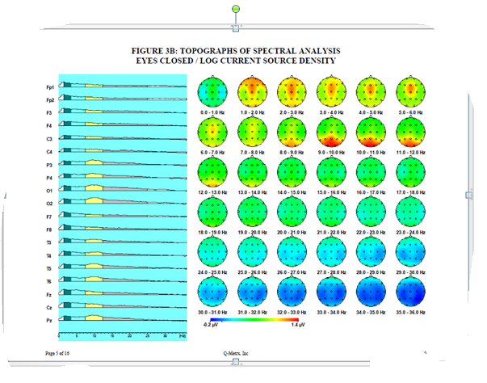

Slide 122
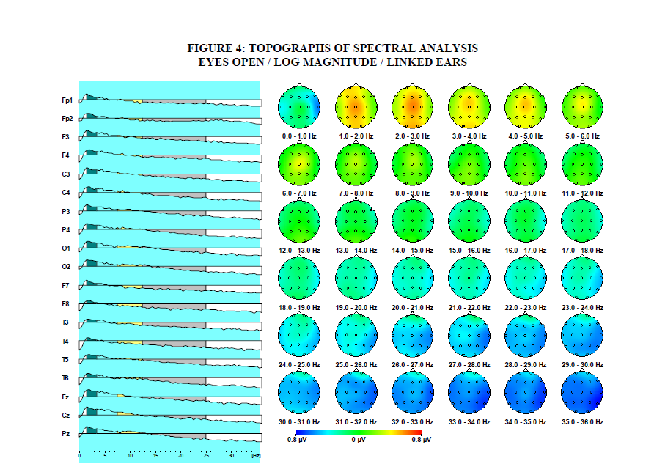

Slide 123
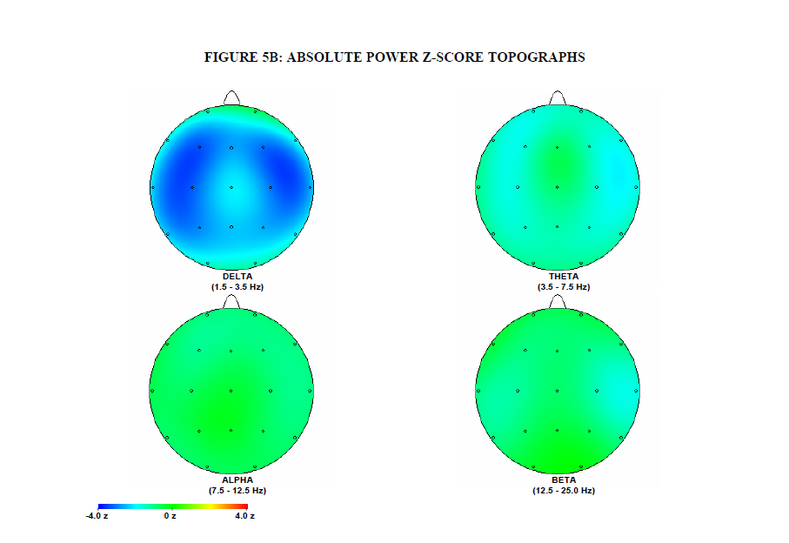

Slide 124
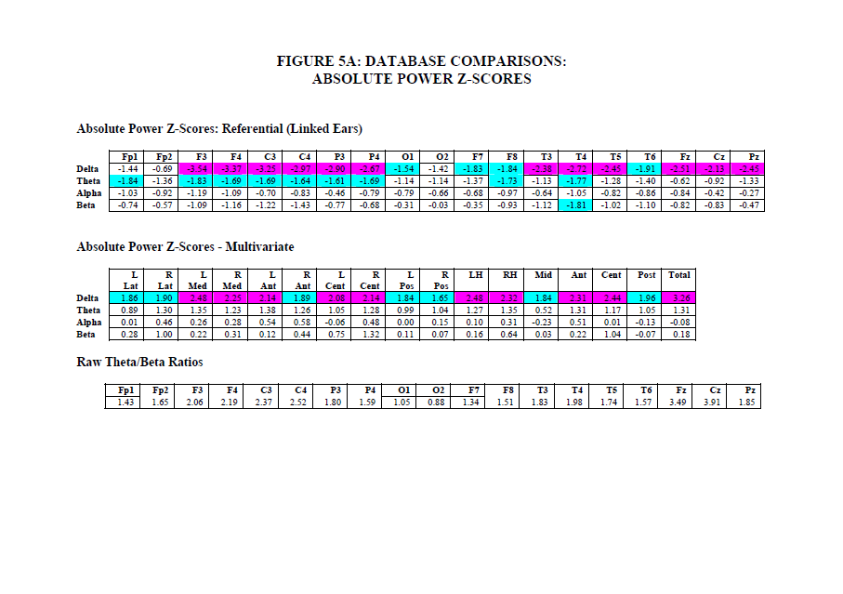

Slide 125
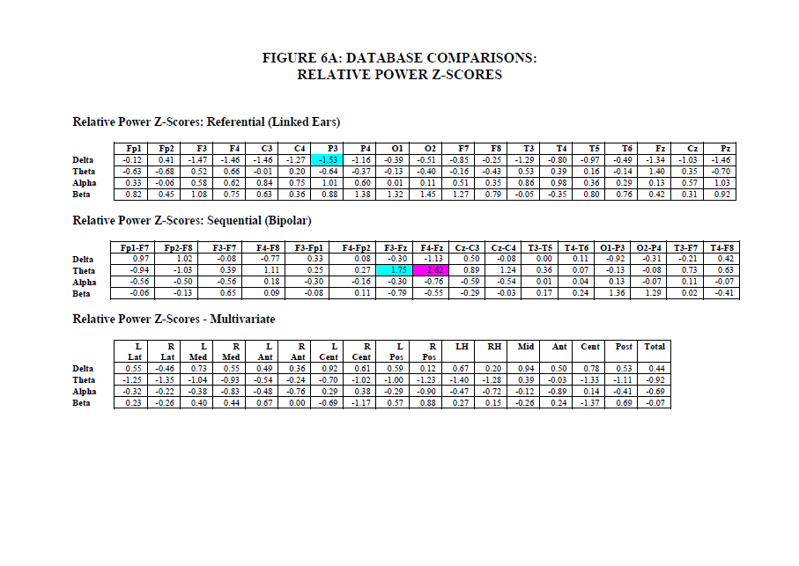

Slide 126
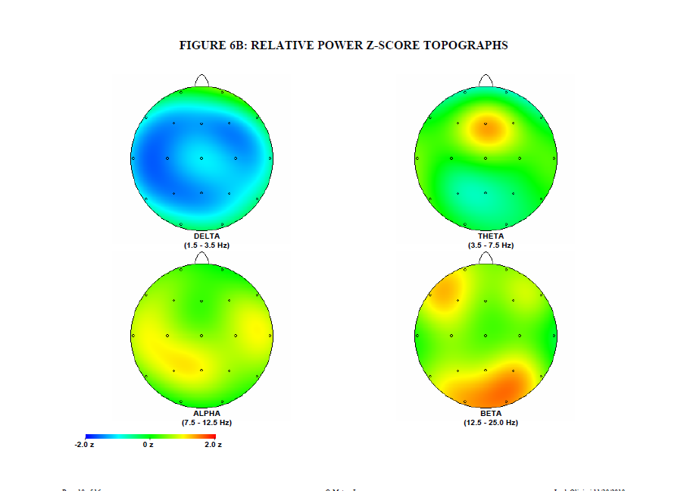

Slide 127
Case Studies
Course of treatment
Sessions 1-7
C3, C4, T3-T4 various frequencies
After session 1, headache rated 0
Session 6 qEEG results rec’d, started CZ 4-7 inh., 15-18 rwd.
Derealization feelings decreased
Sleep improved – onset and maintenance

Slide 128
Case Studies
Sessions 8-34, various frontal placements in various combinations at various frequencies (F3, F4, FZ, FCZ)
Irritability, low self-esteem, depression, fears of not getting better
Depression when having fun, sad about things ending
Somatic complaints
Anxiety at night
Extreme social fears
Negative cognitive set
Headaches tension not migraine

Slide 129
Case Studies
Sessions 35-43
T4 4-7 inh., 1-4 rwd. with one HEG session
Migraine between sessions 42 & 43
Discussion of family issues in tx
Fearful of being normal
Fearful of eating and growing
Discussed interactions with mother

Slide 130
Case Studies
Course of treatment
Session 44 F3 4-7, 22-32 inh., 15-18 rwd.
Sessions 45-48 pIR HEG
Sessions 49-53 T3-T4 4-7, 22-32 inh., 11-14 or 10-13 rwd.

Slide 131
Case Studies
Symptom Pre-Tx Rating 53 Week Rating
Obsessive thoughts (general) 4 2
Fears 3.5 2
Unreal feeling & headache 3 1.5
Panic Attacks 3 1.5
Depression 4 2
Compulsions 2.5 2
Social discomfort 2.5 2.5

Slide 132
Case Studies
Outcome
No migraine headaches after first few sessions until one event between sessions 42 & 43
Became more consistent in practicing hand warming and her exposure exercises
Wider social circle
Better able to tolerate peer conflicts
Affect more animated, greater range and variation
Still significant social anxiety, self-esteem problems

Slide 133
Conclusions
Emerging clinical and experimental literature is promising regarding efficacy
Consistent with neurophysiological literature and learning theory
Relatively low cost
Few groups of individuals that would be unsuitable
Non-invasive
Minimal side effect risk

Slide 134
Suitable for patients who may be in too much discomfort to tolerate talk therapy and may enable them to eventually make use of talk therapy.

Slide 135
Thanks for your attention!

